Slide 1
Boolean Algebra and
Logic Gates
Chapter 2-2
COMP121 Computer Architecture

Slide 2
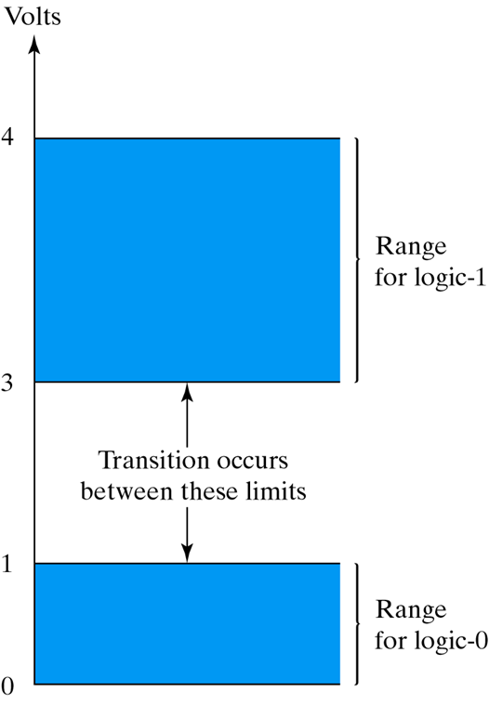
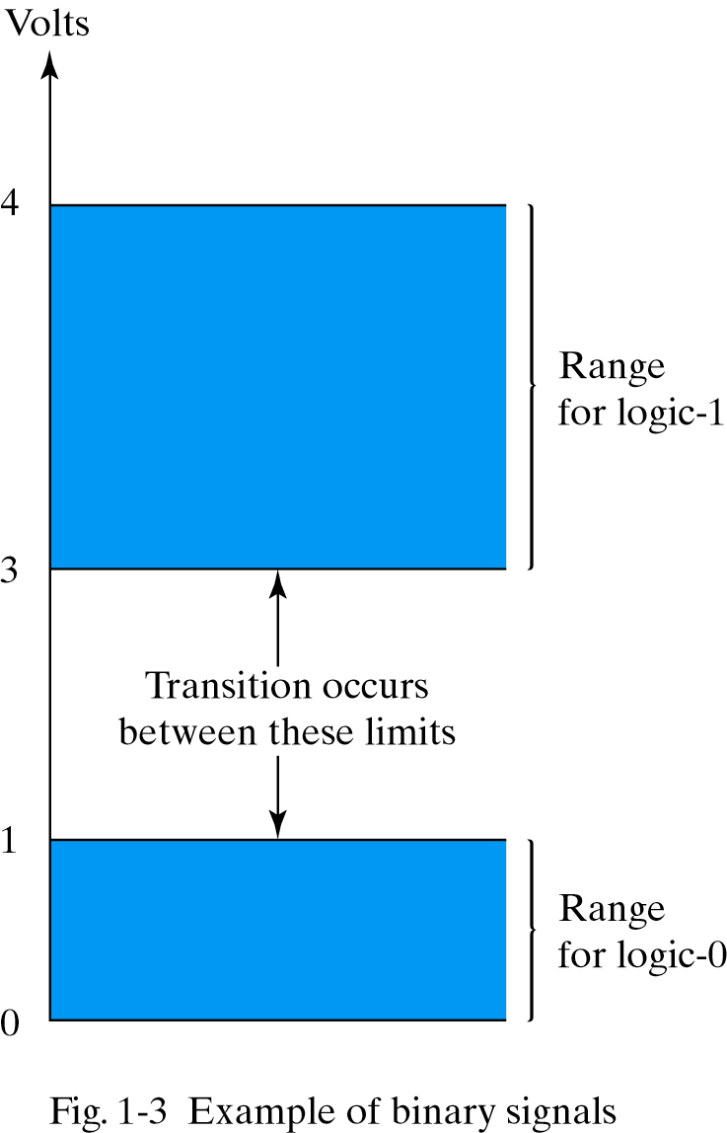
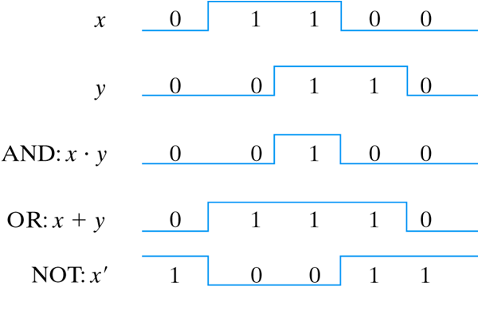
Computer Digital Logic Gates using Volts
COMP121 Computer Architecture

Slide 3
Transistors and Switches
All modern digital logic rests on the fact that a transistor can be make to operate as a very fast binary SWITCH.
A signal between 0 ~ 1 volt binary 0
A signal between 2 ~ 5 volts binary 1
Voltages outside these two ranges are not permitted.
COMP121 Computer Architecture

Slide 4
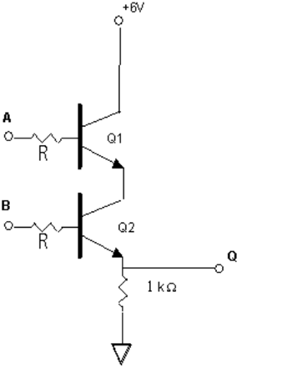
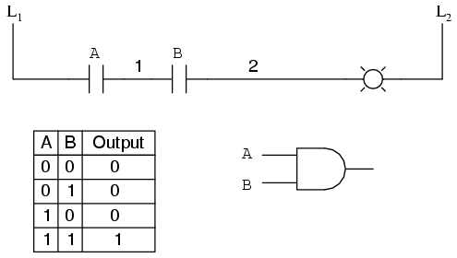
AND Logic
1. AND 0 and 0 =0 (0•0=0)
0 and 1 =0 (0•1=0)
1 and 0 =0 (1•0=0)
1 and 1 =1 (1•1=1)
COMP121 Computer Architecture

Slide 5
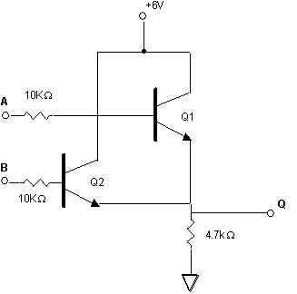
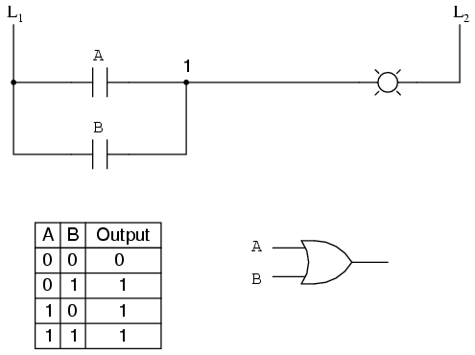
OR Logic
2. OR 0 or 0 =0 (0+0=0)
0 or 1 =1 (0+1=1)
1 or 0 =1 (1+0=1)
1 or 1 =1 (1+1=1)
COMP121 Computer Architecture

Slide 6
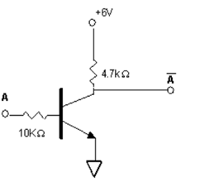
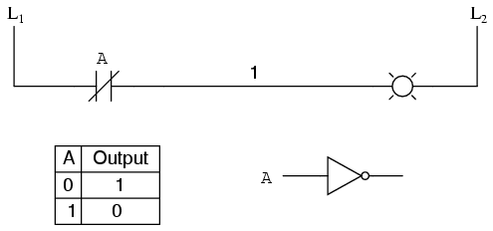
NOT Logic
3. NOT not 0 =1 0’=1
not 1 =0 1’=0
COMP121 Computer Architecture

Slide 7
Properties of Boolean Algebra
(a) Postulates and Theorems of Boolean Algebra
Postulate 2 | (a) x+0=x | (b) x.1=x
Postulate 5 | (a) x+x’=1 | (b) x.x’=0
Theorem 1 | (a) x+x=x | (b) x.x=x
Theorem 2 | (a) x+1=1 | (b) x.0=0
COMP121 Computer Architecture

Slide 8
Properties of Boolean Algebra
(b) Postulates and Theorems of Boolean Algebra
Theorem 3, involution | (a) (x’)’=x
Postulate 3, commutative | (a) x+y=y+x | (b) xy=yx
Theorem 4, associative | (a)x+(y+z)=(x+y)+z | (b) x(yz)=(xy)z
Theorem 4, distributive | (a) x(y+z)=xy+xz | (b) x+yz=(x+y)(x+z)
Postulate 5, DeMorgan | (a) (x+y)’=x’y’ | (b) (xy)’=x’+y’
Theorem 6, absorption | (a) x+xy=x | (b) x(x+y)=x
COMP121 Computer Architecture

Slide 9
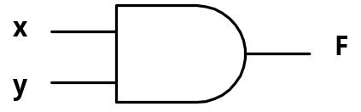
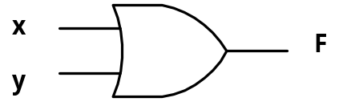

Graphic Symbols of Logic Gates
Name
Graphic Symbol
Algebraic Function
AND
F=xy
OR
F=x+y
Inverter
F=x’
COMP121 Computer Architecture

Slide 10
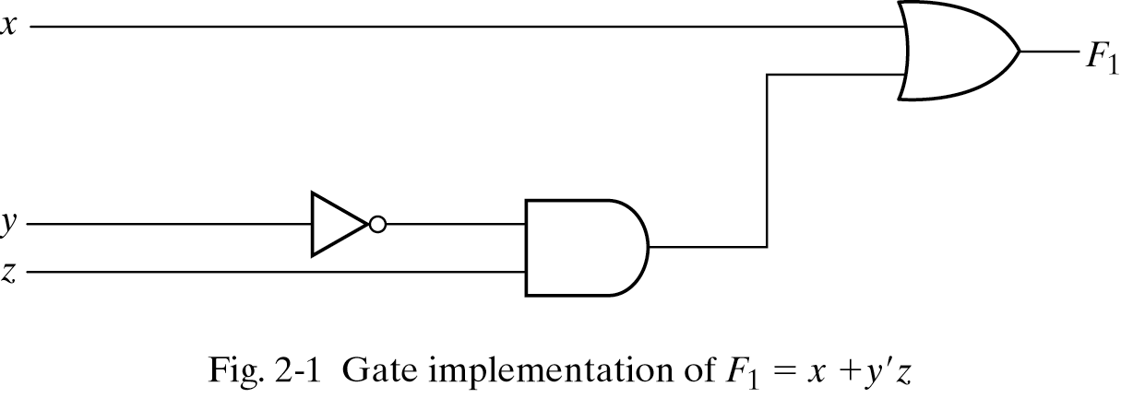
Gate Implementation
COMP121 Computer Architecture

Slide 11
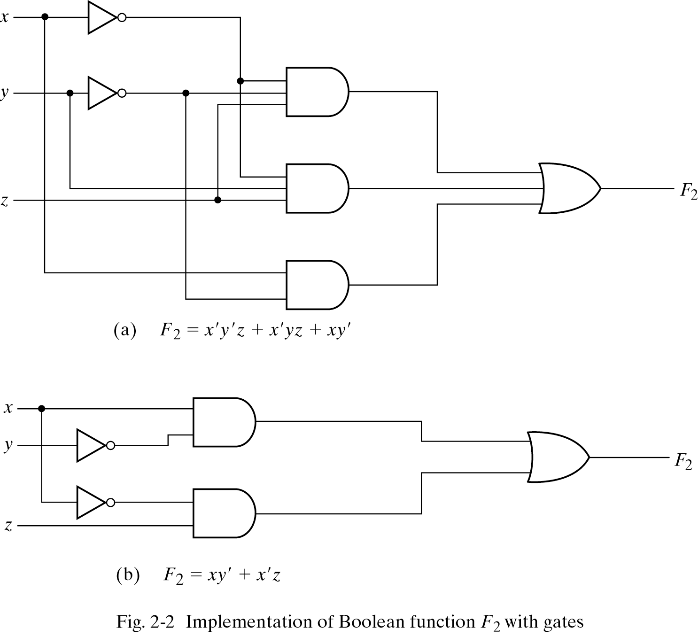
Gate
Implementation
COMP121 Computer Architecture

Slide 12
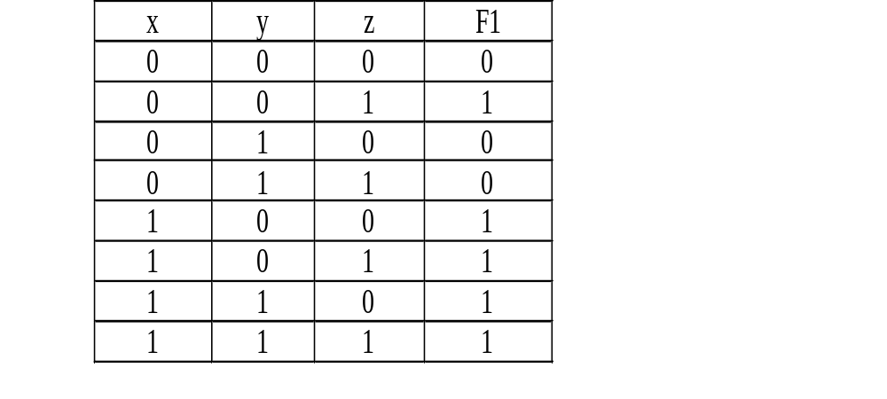
Truth Table
A truth table is a list of combinations 1’s and 0’s assigned to the binary variables and a column that shows the value of the function for each binary combination.
The number of rows in the truth table is 2^{n}, where n is the number of variables in the function.
F₁=x+y’z
COMP121 Computer Architecture

Slide 13
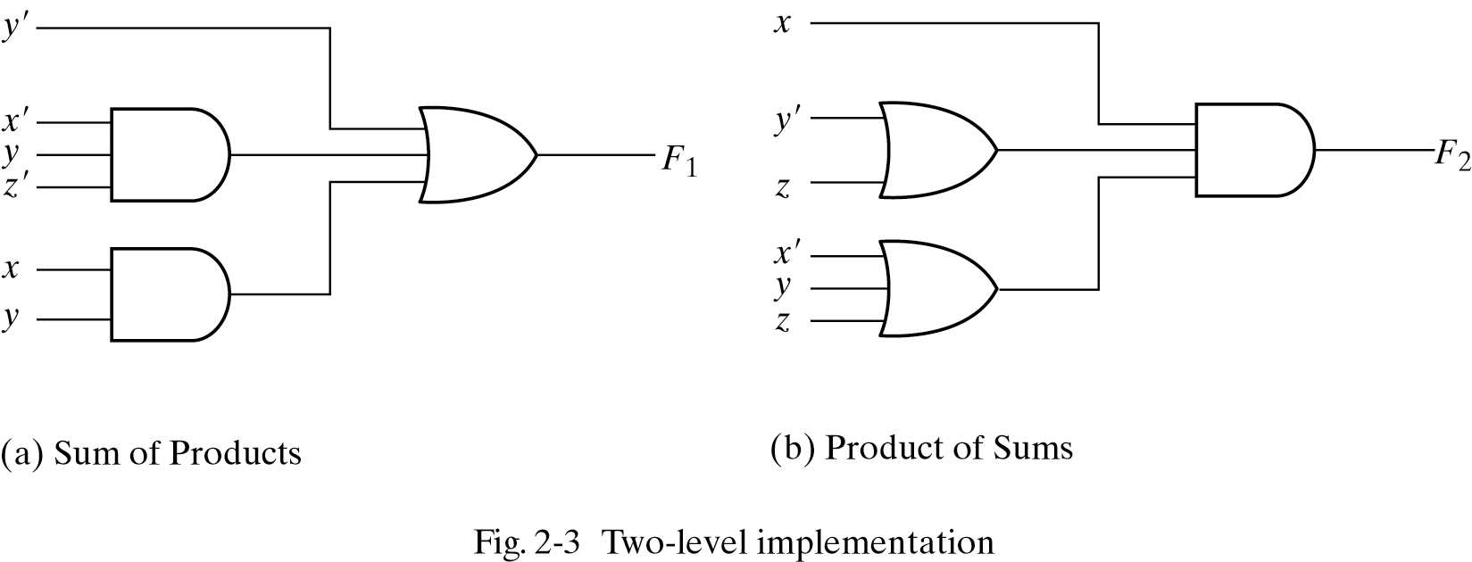
Two-level Logic Gates Implementation
The logic diagram of a sum-of-products expression consists of a group of AND gates followed by a single OR gate.
The logic diagram of a products-of-sum expression consists of a group of OR gates followed by a single AND gate.
F1=y’+xy+x’yz’
F2=x(y’+z)(x’+y+z’)
COMP121 Computer Architecture

Slide 14
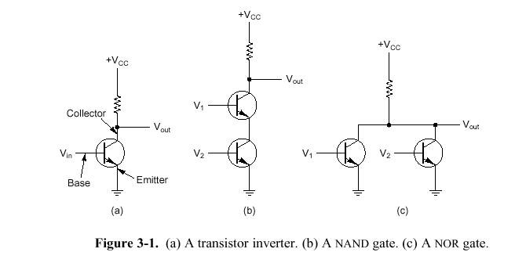
NAND and NOR with Transistors
Two transistors are cascaded in series, a NAND gate
Two transistors are wired in parallel, a NOR gate
COMP121 Computer Architecture

Slide 15
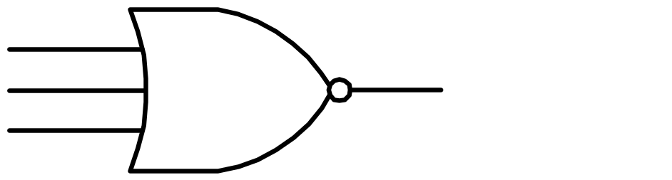
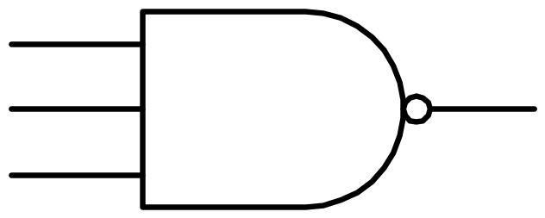
Extension to Multiple Inputs
x
y
(x+y+z)’
z
(a) Three-input NOR gate
x
y
(xyz)’
z
(b) Three-input NAND gate
COMP121 Computer Architecture

Slide 16
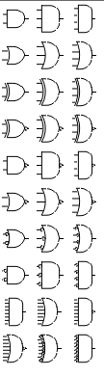
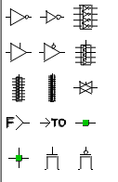
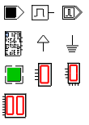
Basic Input/Output in the Simulator
COMP121 Computer Architecture

